Slide 1
Country name
Date

Slide 2
What will it take to saturate this nation with the Kingdom of God?
The big question:

Slide 3
Outcomes we are praying for:
Develop relationships that facilitate collaboration.
Understand Saturation Church Planting best-practice.
Objectives agreed to develop an effective Saturation Church Planting national roundtable.
Clear objectives agreed to develop roundtable expressions in every province.

Slide 4
The program

Slide 5
The consultation process
Where are we?
Where God wants us to go?
How are we going to get there?

Slide 6
The final presentations to be given on the last day.

Slide 7
Step one: Where are we now?
Where are we?
Taking the pulse

Slide 8
Additional input (results of prior consultations)

Slide 9
Discovering A Way Forward C2S in the nation Table groups

Slide 10
7 steps to clarify where you are now. - Worksheet Steps 1-3

Slide 11
Take a selfie of C2S in your nation - Dashboard

Slide 12
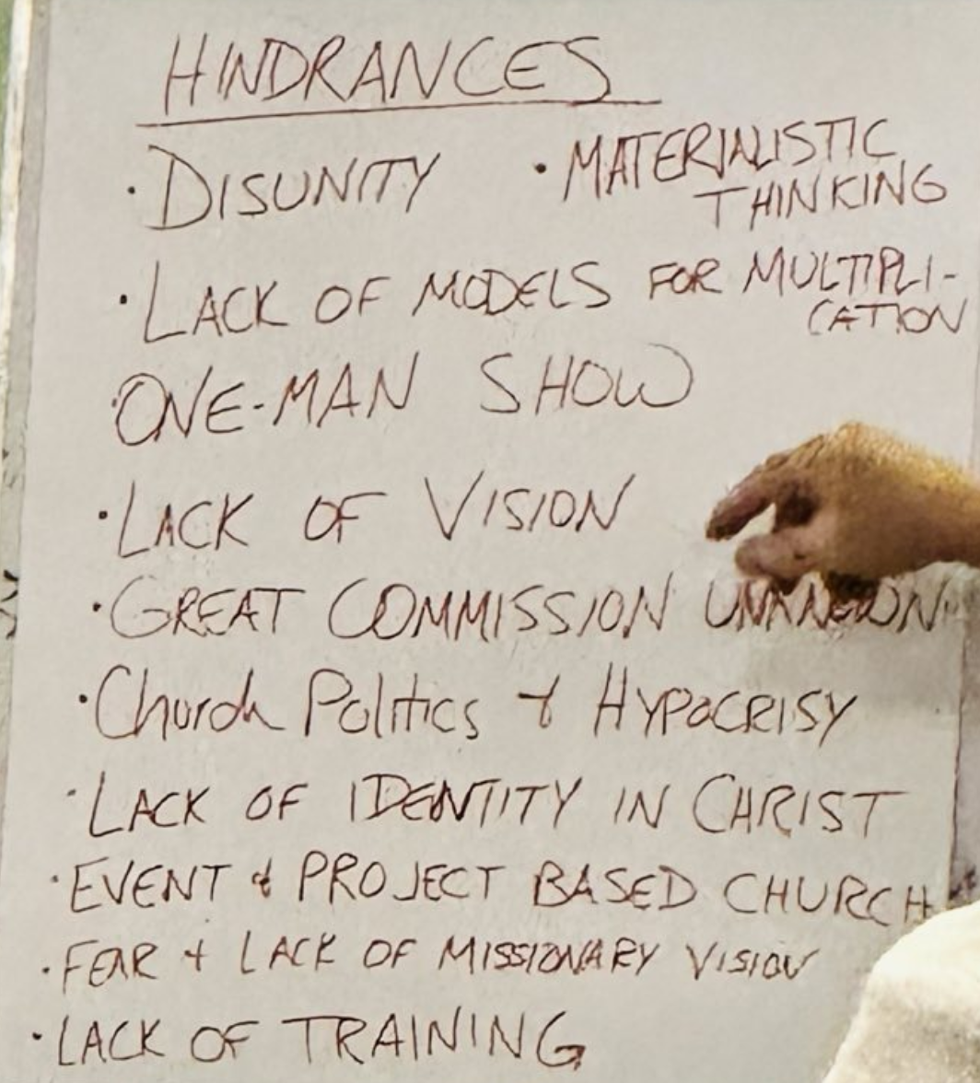
Review the hinderences
Compile a list of the main hindrances, maybe one from each table.

Slide 13
Step two of the consultation process
Where does God want us to go?

Slide 14
What is God´s vision for C2S in your nation?
Vision
Objectives
3
2
1
Where we are today.

Slide 15
Round table for collaboration to saturate the nation with the Gospel
A round table gathering is most effective when it gives a platform for the the various alliances, denominations, organizations involved in church planting in a nation to listen to each other and make and work a collaborative vision together.

Slide 17
Step 3 of the consultation process
How are we going to get there?

Slide 19
The final presentations to be given on the last day.

Slide 20
Invitation to commit

