Slide 1
Country Name
Date

Slide 2
What will it take to saturate our nation with the gospel through church multiplication?
THE BIG QUESTION:

Slide 3
Outcomes we are praying for:
Develop relationships that facilitate collaboration.
Understand Saturation Church Planting best-practice.
Objectives agreed to develop an effective Saturation Church Planting national roundtable.
Clear objectives agreed to develop roundtable expressions in every province.

Slide 4
The program

Slide 5
The Consultation Process
1. WHERE ARE WE NOW?
2. WHERE DOES GOD WANT US TO GO?
3. HOW ARE WE GOING TO GET THERE?

Slide 6
The final presentations to be given on the last day.
TON - THIS SLIDE IS REPEATED AT THE END, DO WE NEED IT HERE?

Slide 7
Step 1: Where are we now? Taking the Pulse
1. WHERE ARE WE NOW?
2. WHERE DOES GOD WANT US TO GO?
3. HOW ARE WE GOING TO GET THERE?

Slide 8
Additional input (results of prior consultations)

Slide 9
Discovering a Way Forward
C2S in the nation Table groups

Slide 10
7 steps to clarify where you are now: Worksheet Steps 1-3

Slide 11
Worksheet Step 3: Take a selfie of C2S in your nation (Dashboard)

Slide 12
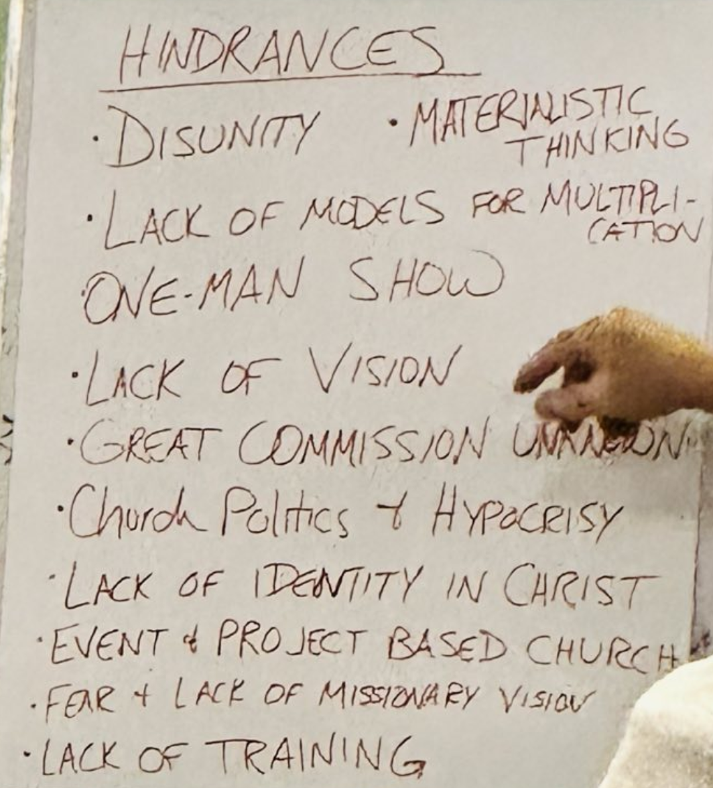
Review the hinderences
Compile a list of the main hindrances, maybe one from each table.

Slide 13
Step 2: Where does God want us to go?
1. WHERE ARE WE NOW?
2. WHERE DOES GOD WANT US TO GO?
3. HOW ARE WE GOING TO GET THERE?

Slide 14
What is God’s vision for C2S in your nation?
Where are we today?
Objective 1
Objective 2
VISION
Objective 3

Slide 15
Round table for collaboration to saturate the nation with the Gospel
A round table gathering is most effective when it gives a platform for the various alliances, denominations, organizations involved in church planting in a nation to listen to each other and make and work a collaborative vision together.

Slide 16
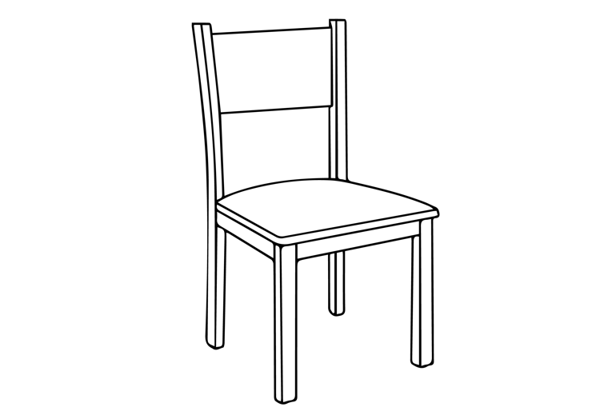
The Empty Chair
Welcome!
There is room for more networks to join!

Slide 17
Step 3: How are we going to get there?
1. WHERE ARE WE NOW?
2. WHERE DOES GOD WANT US TO GO?
3. HOW ARE WE GOING TO GET THERE?

Slide 18
What is God putting in your heart to believe for?
What will you be celebrating together in 2030 regarding C2S in your nation?
Step 4: Vision Casting

Slide 19
Step 5: Clarify key things to be done to accomplish the vision
Step 6: Next Steps
What?
Where?
How?

Slide 20
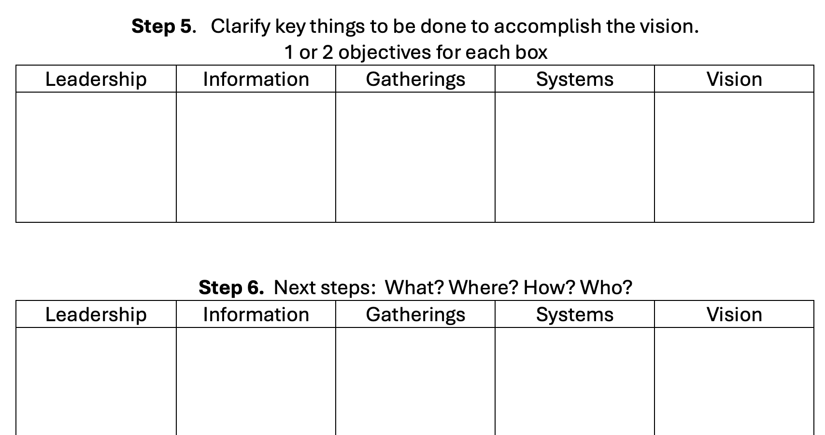

Slide 21
The final presentations to be given on the last day.

Slide 22
Invitation to commit

Slide 24
Thank you!

