Slide 1

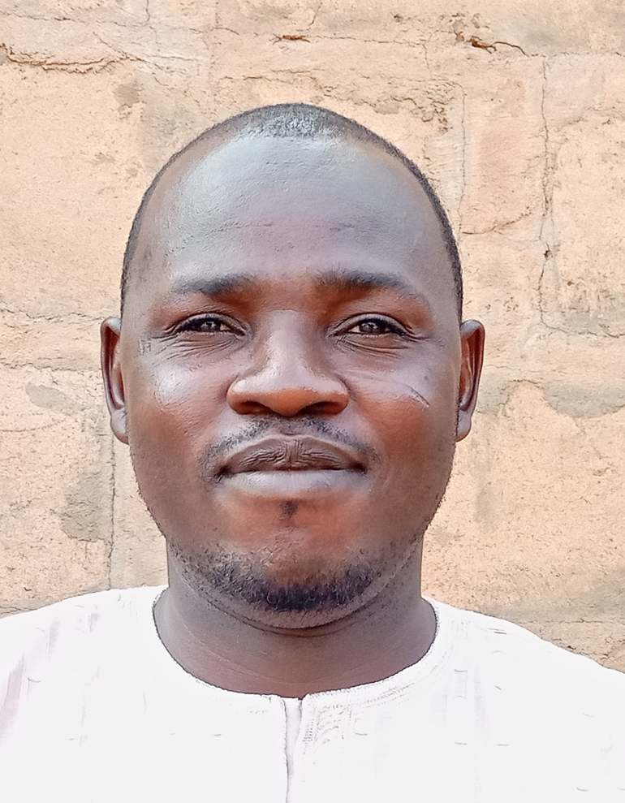
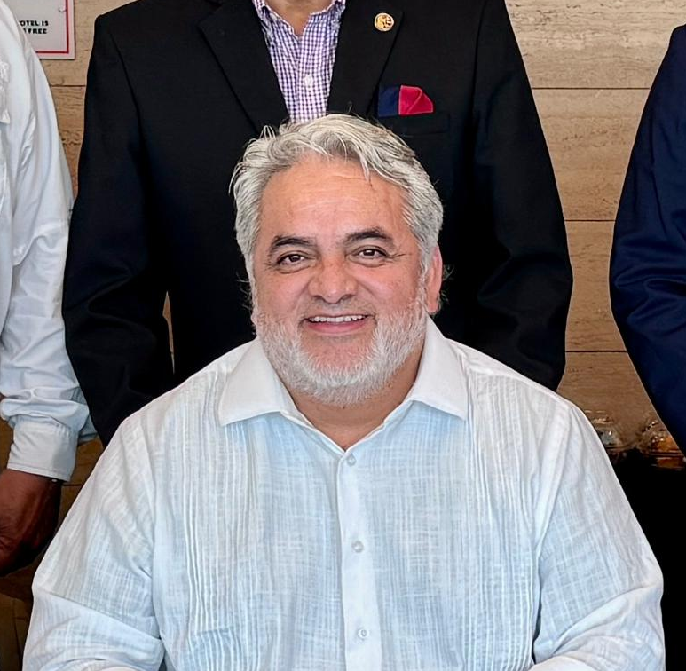
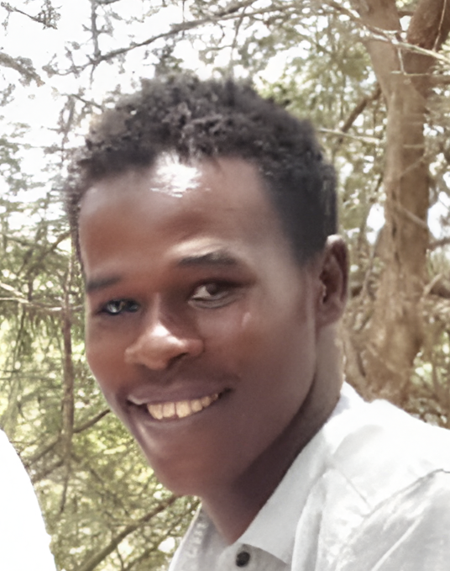
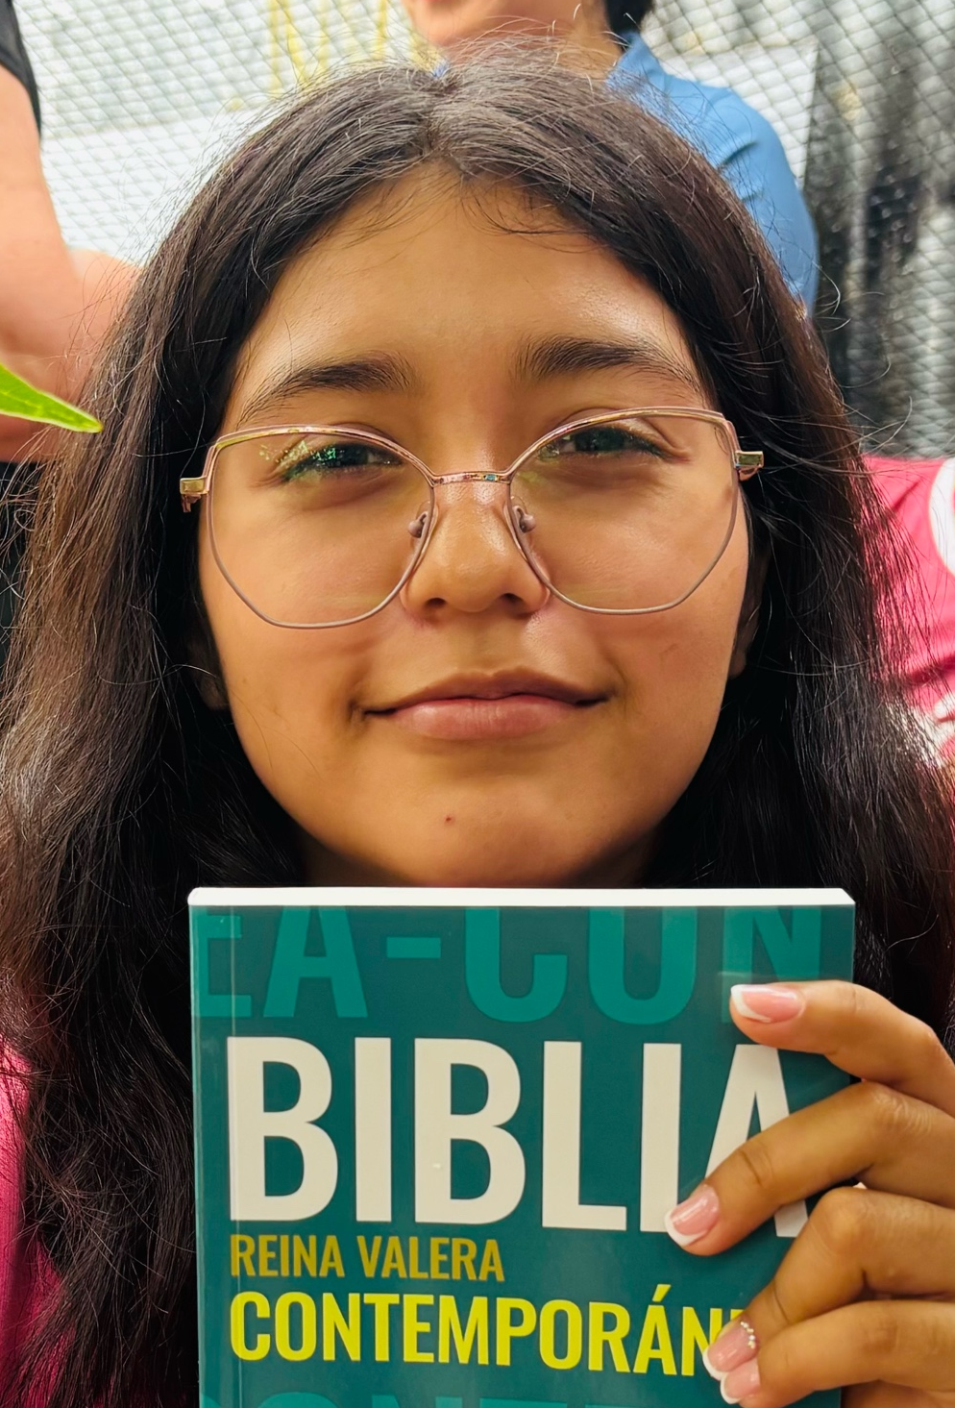
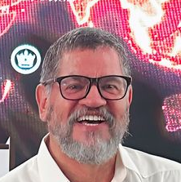
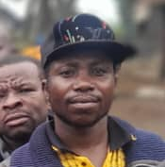
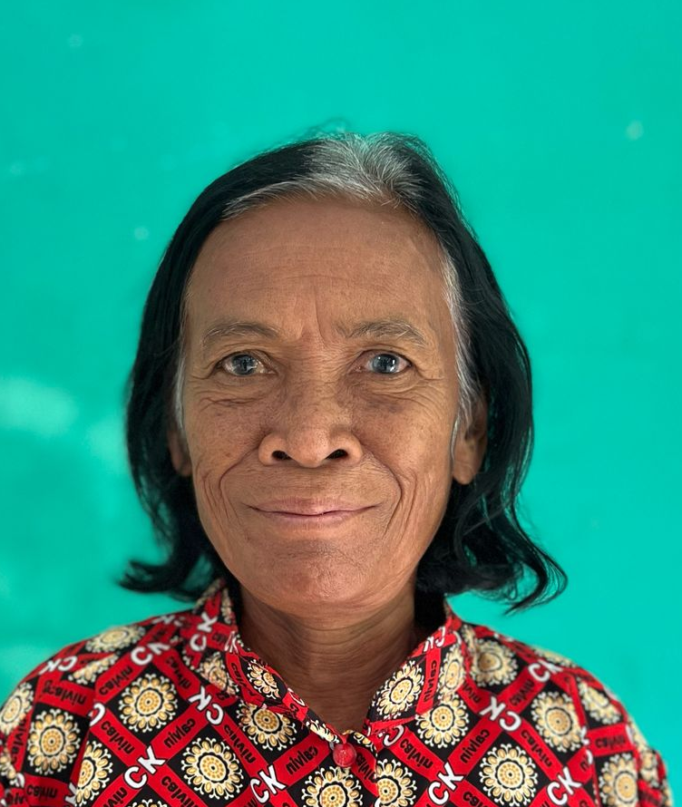
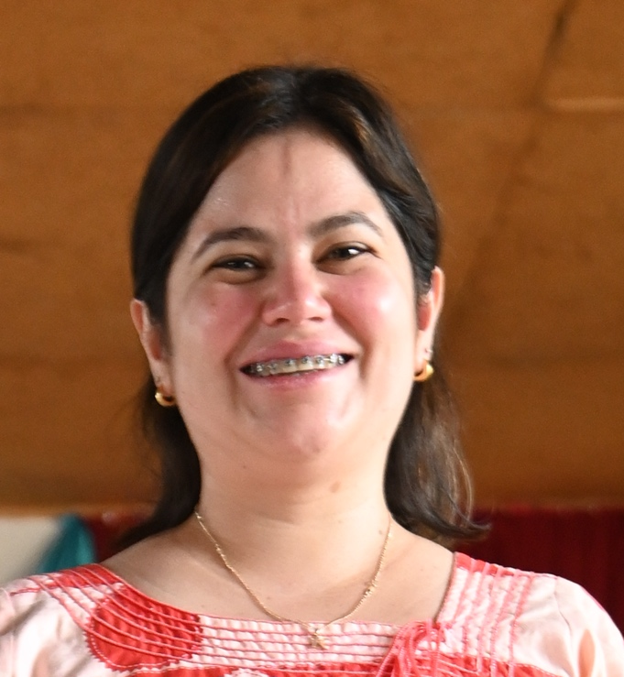
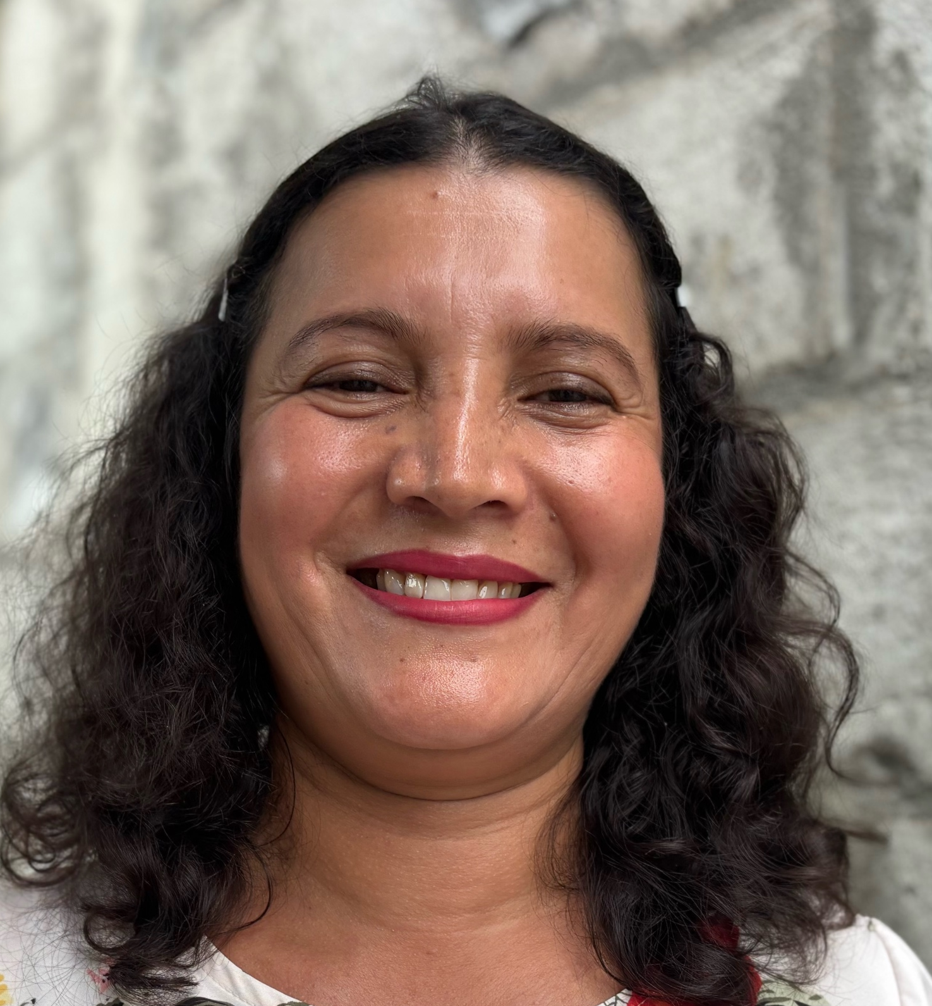
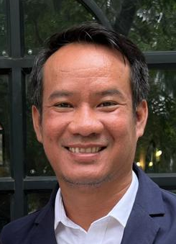
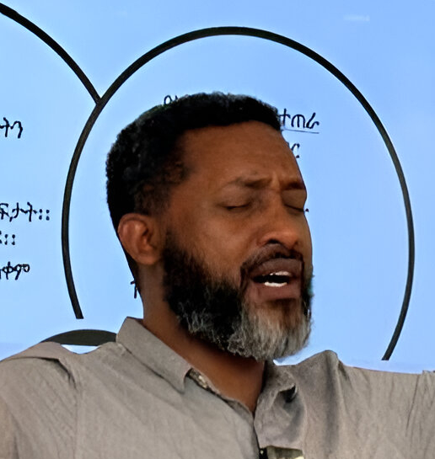
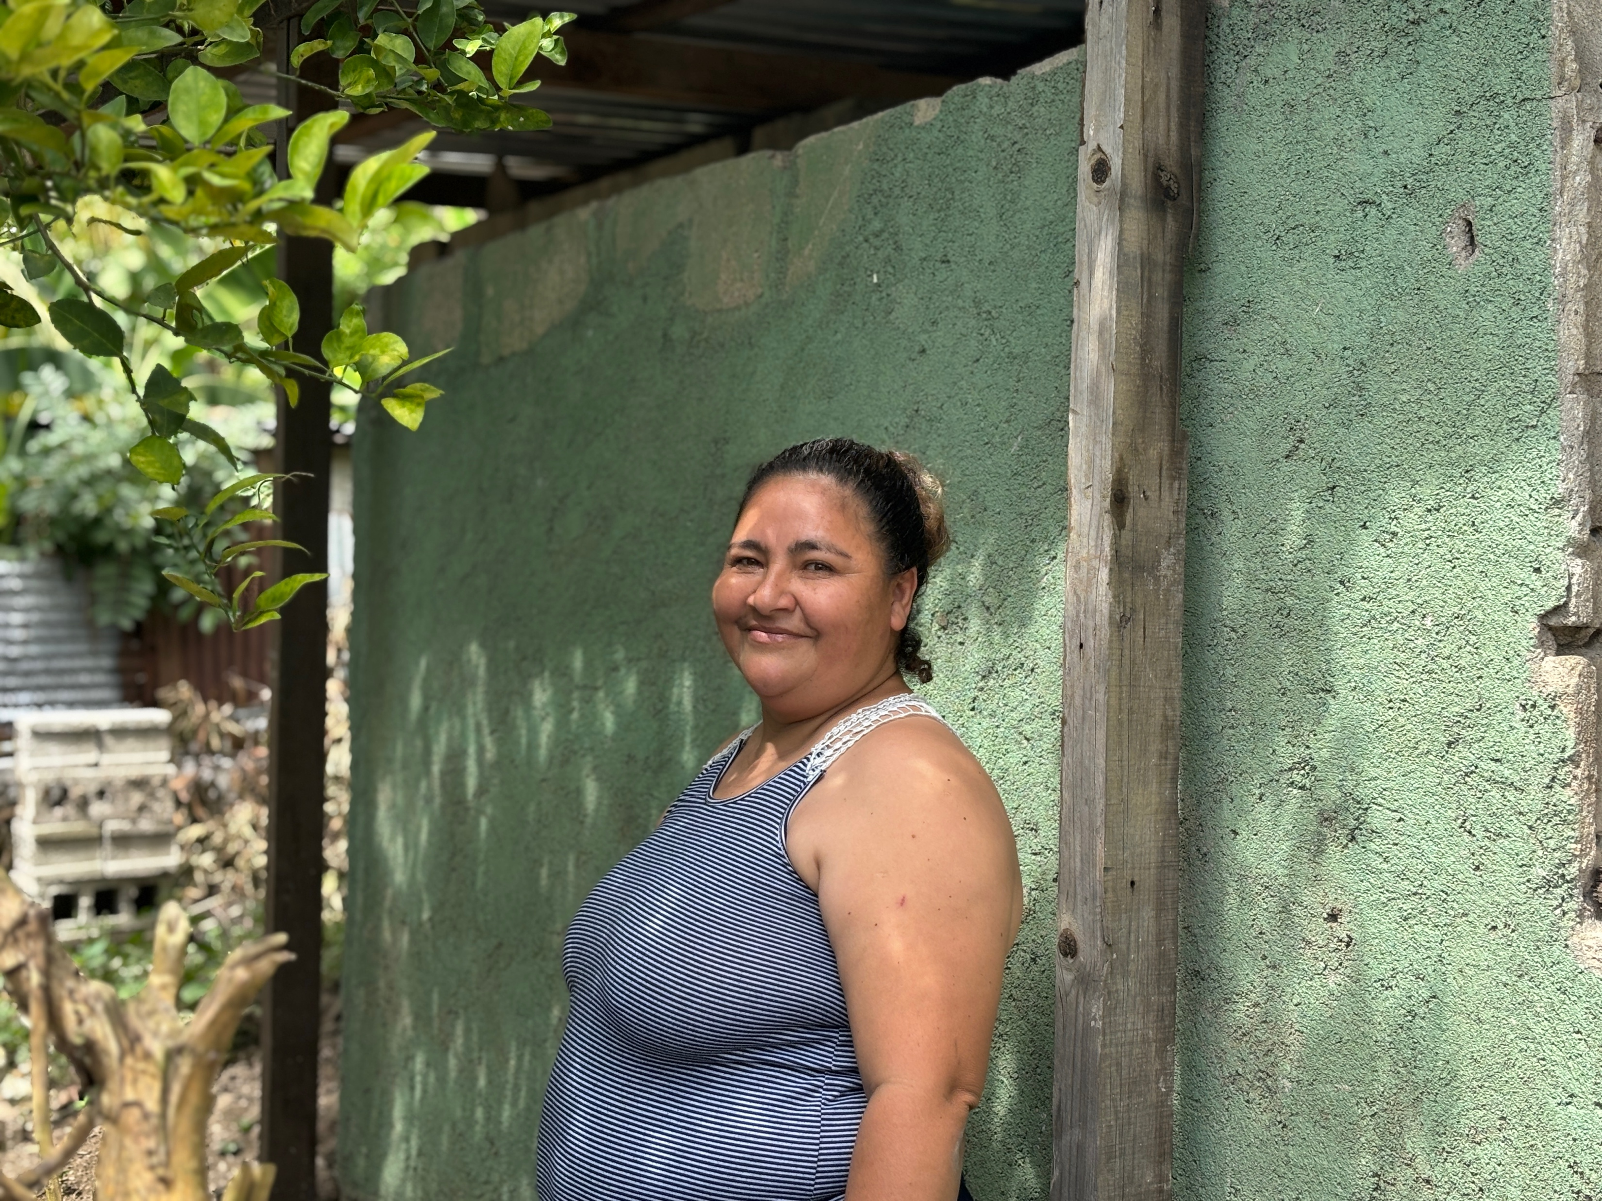

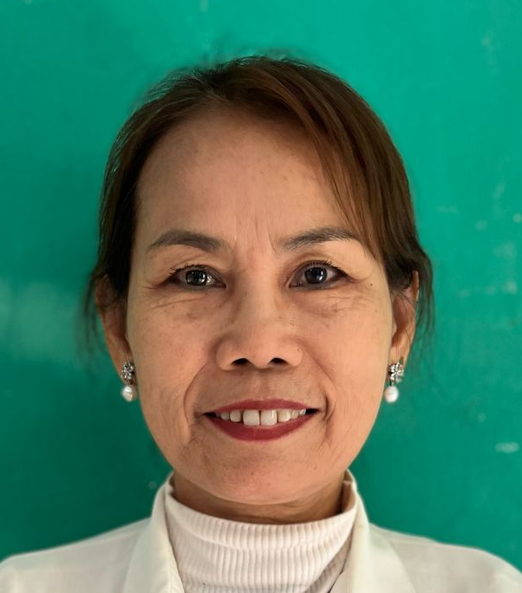
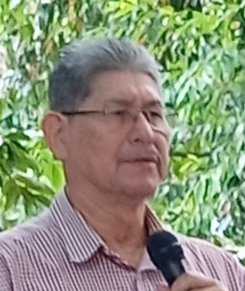
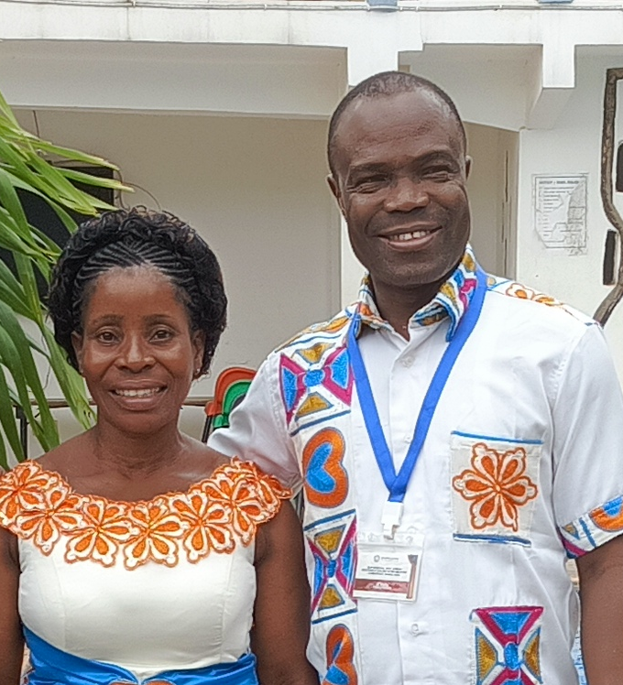
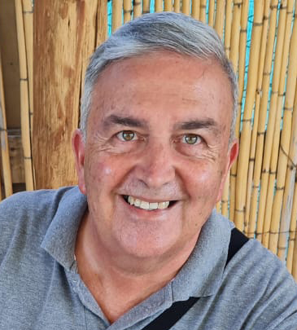

A Call to
Collaborate

Slide 2






You are invited to
Collaborate to Saturate

Slide 3

The Empty Chair
Welcome!
There is room for more networks to join!

Slide 4
Help be the answer to this core question: What will it take to saturate our nation with the gospel through church multiplication?

Slide 5
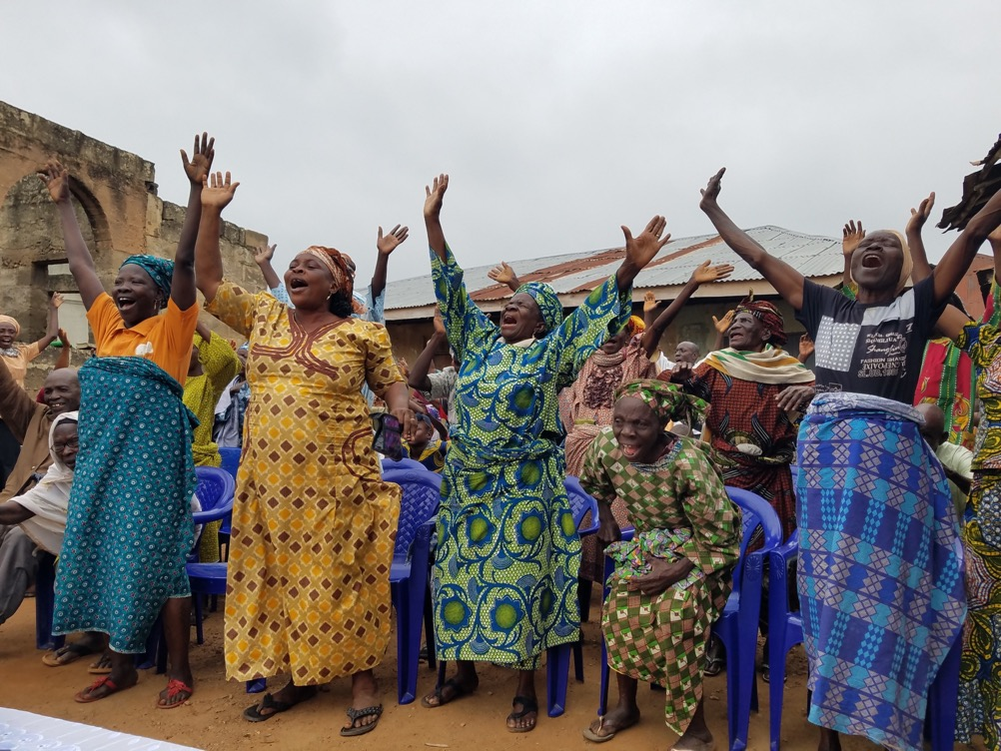
What?
Collaborate to Saturate is
An invitation to collaborate to saturate the nations with disciple-making churches.
In obedience to the Great Commission and in the spirit of Jesus’ prayer of John 17 we collaborate to saturate every linguistic, ethnic, geographic and social space of our nation with churches that multiply disciples.

Slide 6
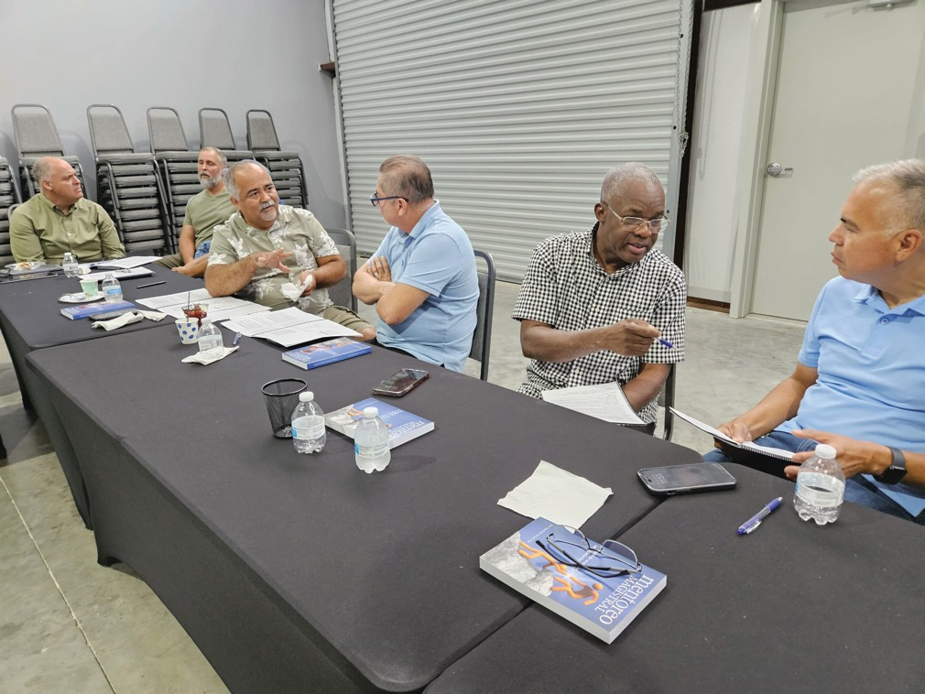
Why?
We do this to participate in the triune God’s redemptive mission in the world.
INVITATION
Collaborate to Saturate invites you to participate in a collaborative conversation or roundtable near you.
What is a collaborative roundtable? Here is an example….

Slide 7
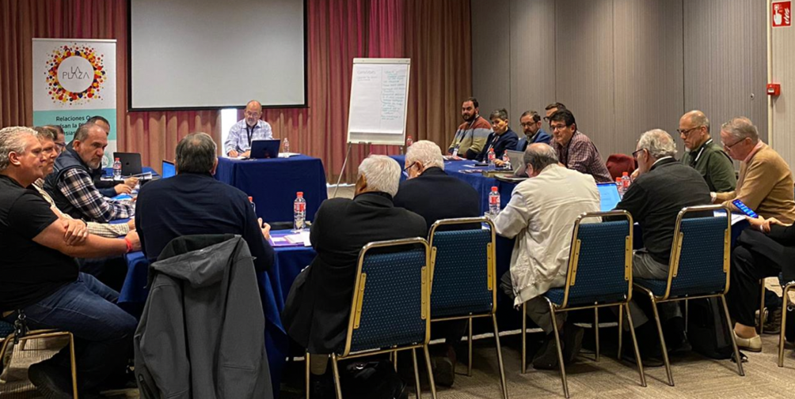




A collaborative roundtable involves…
Relationships that propel the planting of churches
A team of leaders comes together to coordinate the efforts of saturating a country with multiplying churches.
Influencers gather to pray and strategize about the multiplication of churches and disciples.
Leaders representing as many church groups and organizations as possible are included.
La Plaza leaders coming together in Spain to discuss the advance of the Gospel and how to saturate the country with disciple making churches.

Slide 8
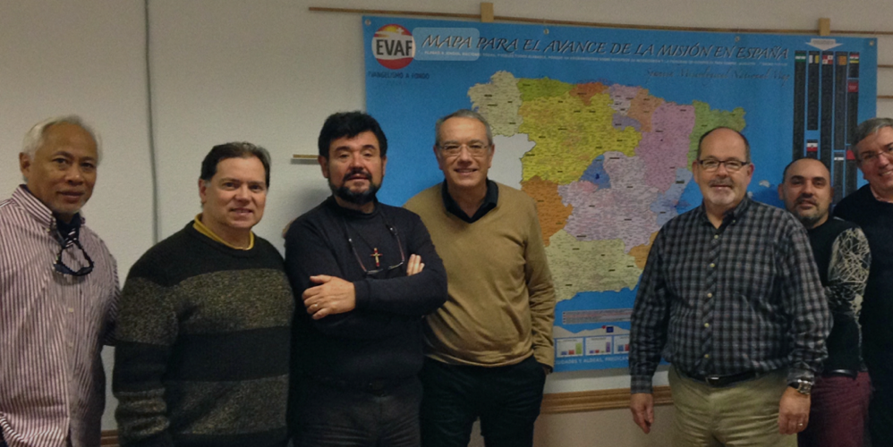


A collaborative roundtable involves…
Information that guides decision making
Where are the places on the map where more churches are needed?
Where are the unreached people groups?
What kind of people are more receptive? Where are more efforts needed?
How can information be shared, as appropriate, taking seriously the local context?

Slide 9
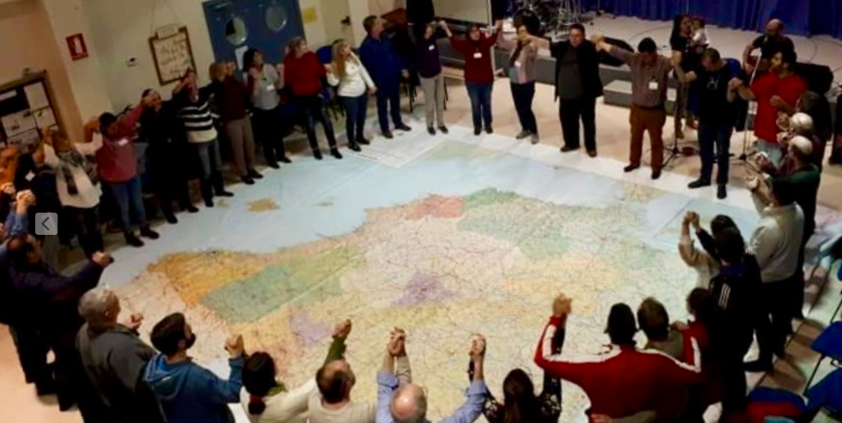

A collaborative roundtable involves…
Looking at the whole nation together
Gatherings are organized as needed to pray, share ideas, set goals and evaluate progress. A spirit of unity in the mission pervades the gathering and leaders encourage one another respecting the different approaches and perspectives on the mission.

Slide 10
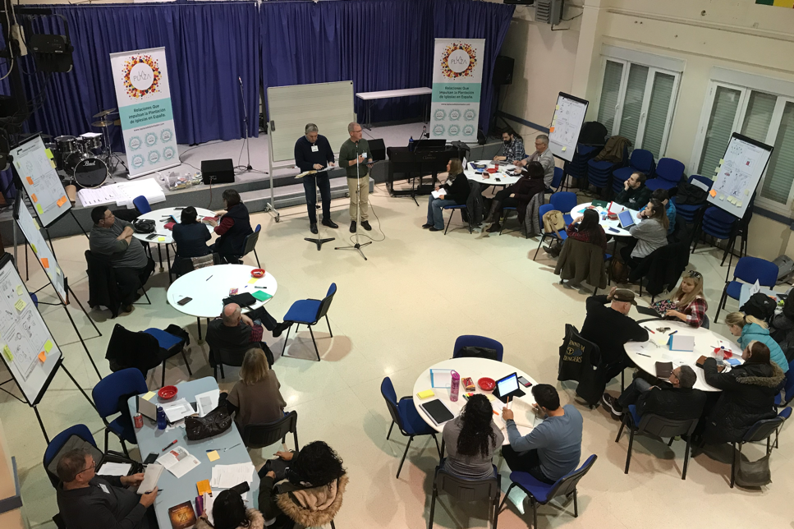

A collaborative roundtable involves…
A place for every system that promotes saturation
Organizations that provide systems, tools, processes, materials, mentoring, coaching and training are invited to collaborate in the implementation of the plans to saturate the nation with multiplying churches and missional communities. The spirit of Collaborate to Saturate is inclusive, with an emphasis on grassroots collaboration and action.

Slide 11
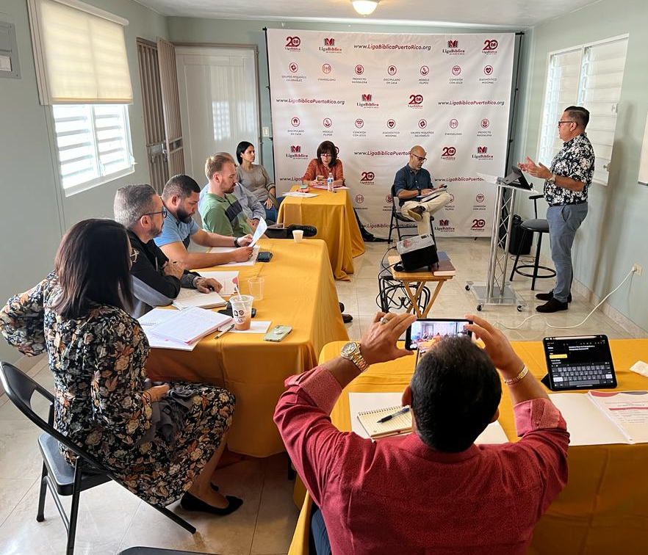
Working Table
in Puerto Rico

Slide 12
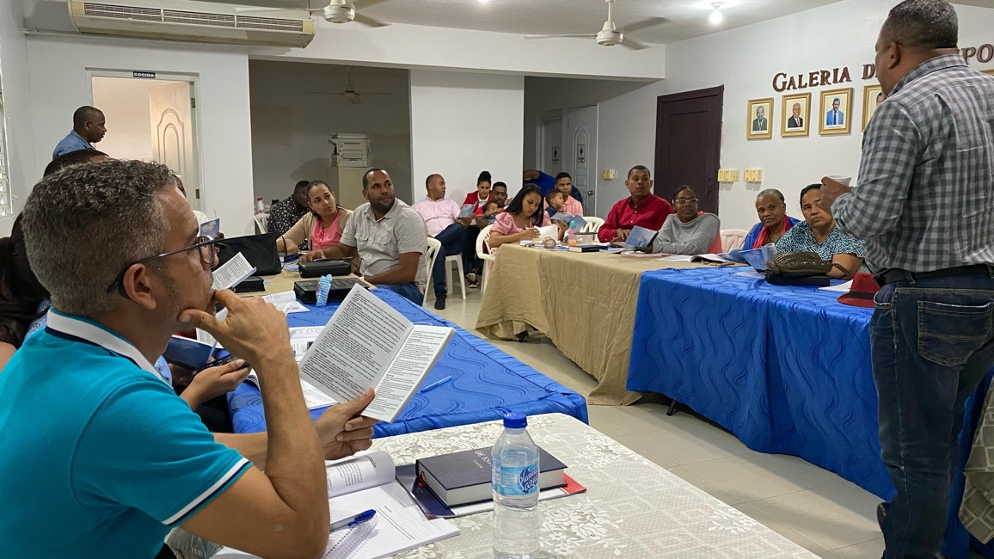
Working Table in Dominican Republic

Slide 13















Another example:
Dominican Republic: many denominations and networks – One Goal!

Slide 14
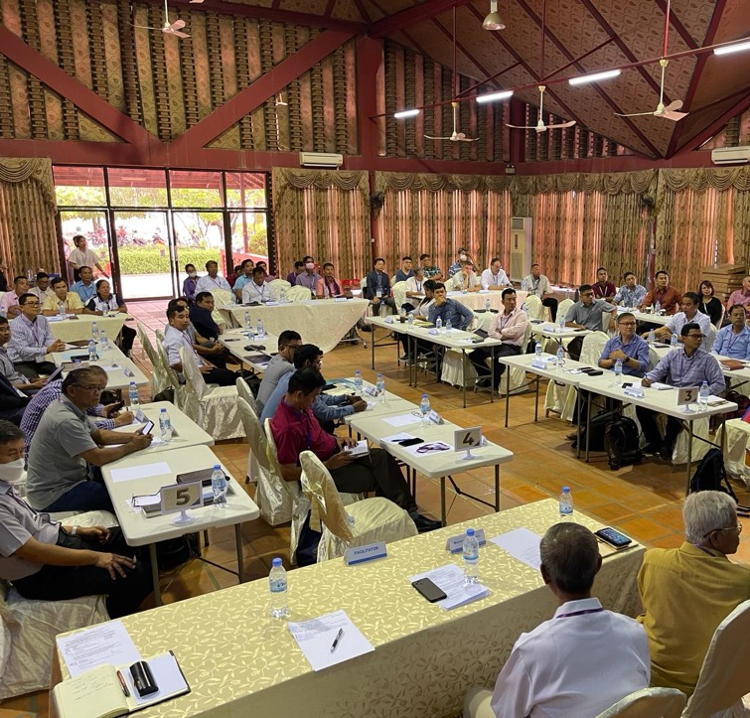
Other examples
Cambodia
2nd Roundtable Gathering
78 leaders from different denominations and ministries
21 ministries/organizations represented
Every organization had an opportunity to share about their efforts and strategies.
Every organization marked on the map where they are working.

Slide 15
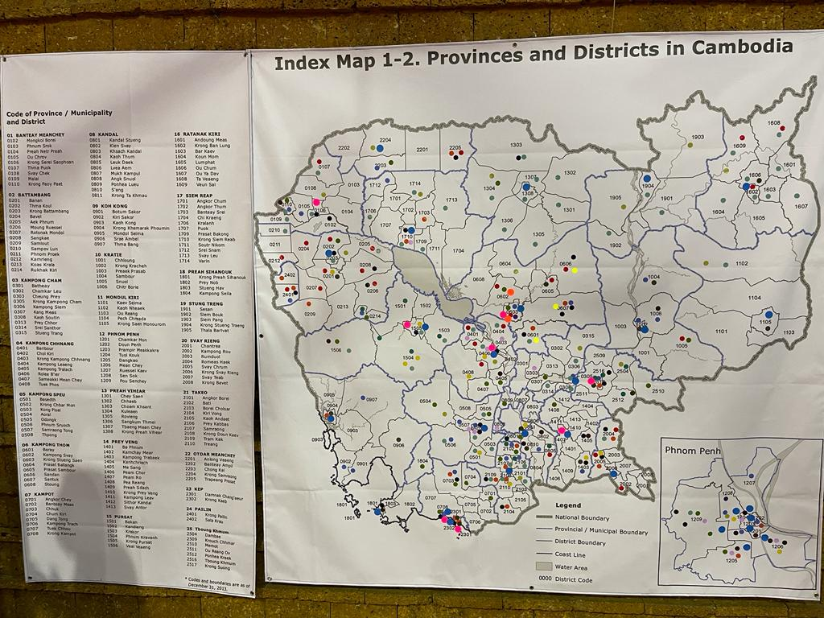
Cambodia

Slide 16
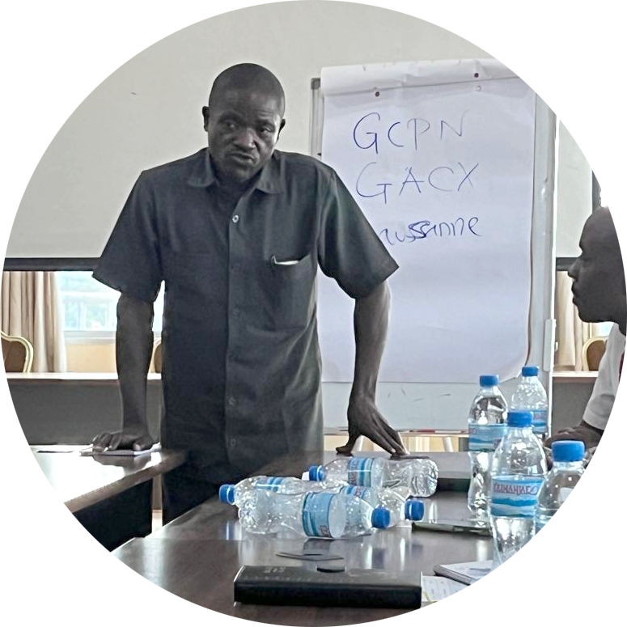
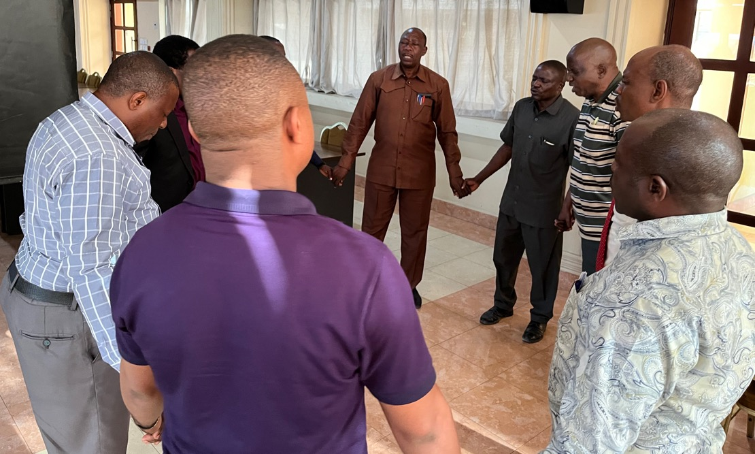
Tanzania

Slide 17
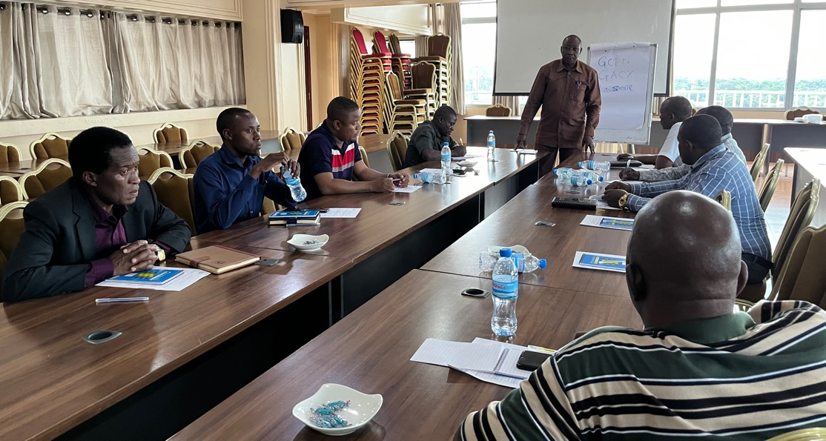
Tanzania

Slide 18
Our specific goal:
To establish an effective disciple-making, church planting roundtable in each nation, supported by regional collaborative gatherings.

Slide 19
An invitation to collaborate to saturate the nations with disciple making churches document is available on the home page of collaborate2saturate.org along with a PowerPoint. This one-page document provides a general agreement that can be signed by those wishing to collaborate together.

Slide 20
Collaborate to saturate invites us to work and pray for… Progression Namely, growing health in all four stages of collaboration
1
Leadership Team/Catalysts | Strategic Information | National Gatherings | Systems Tools/Training

Slide 21
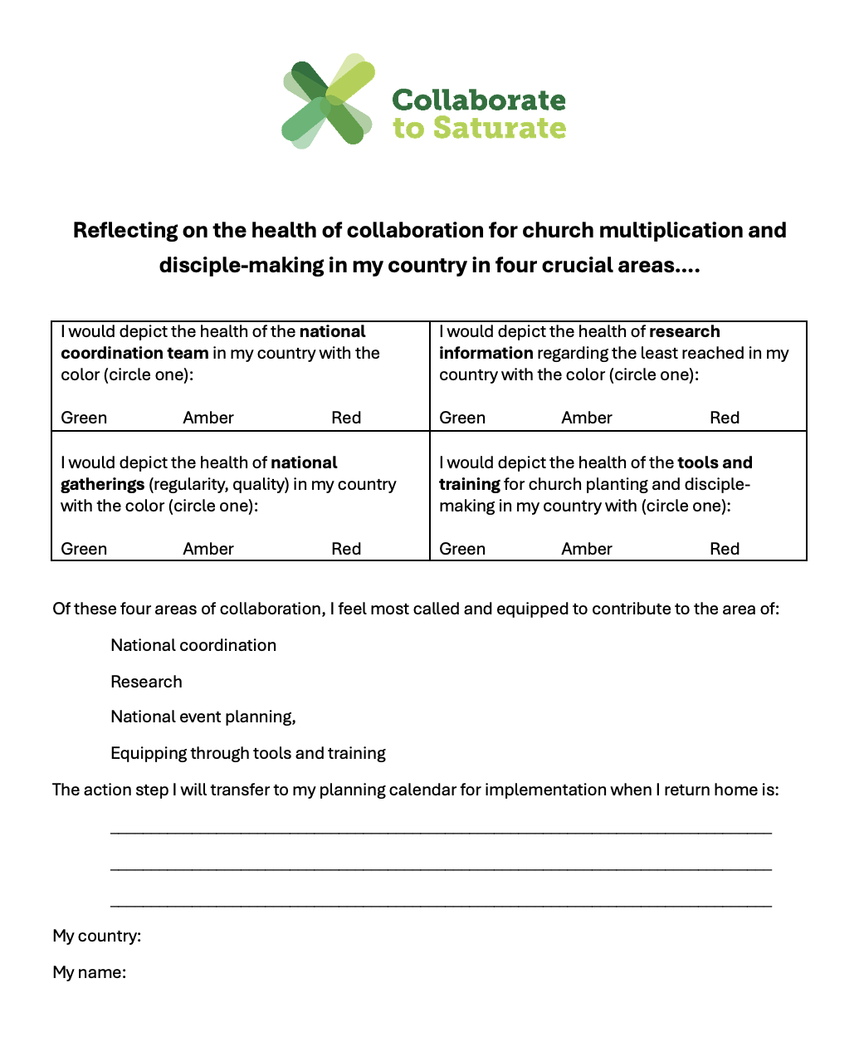
Church multiplication and disciple-making in my country

Slide 22

Collaborate to saturate invites us to work and pray for… Healthy and effective collaboration in 200 nations
2
Church leaders in very nation are passionately active in collaboration for effective church multiplication “that all may know” in answer to Jesus’ prayer of John 17.

Slide 23
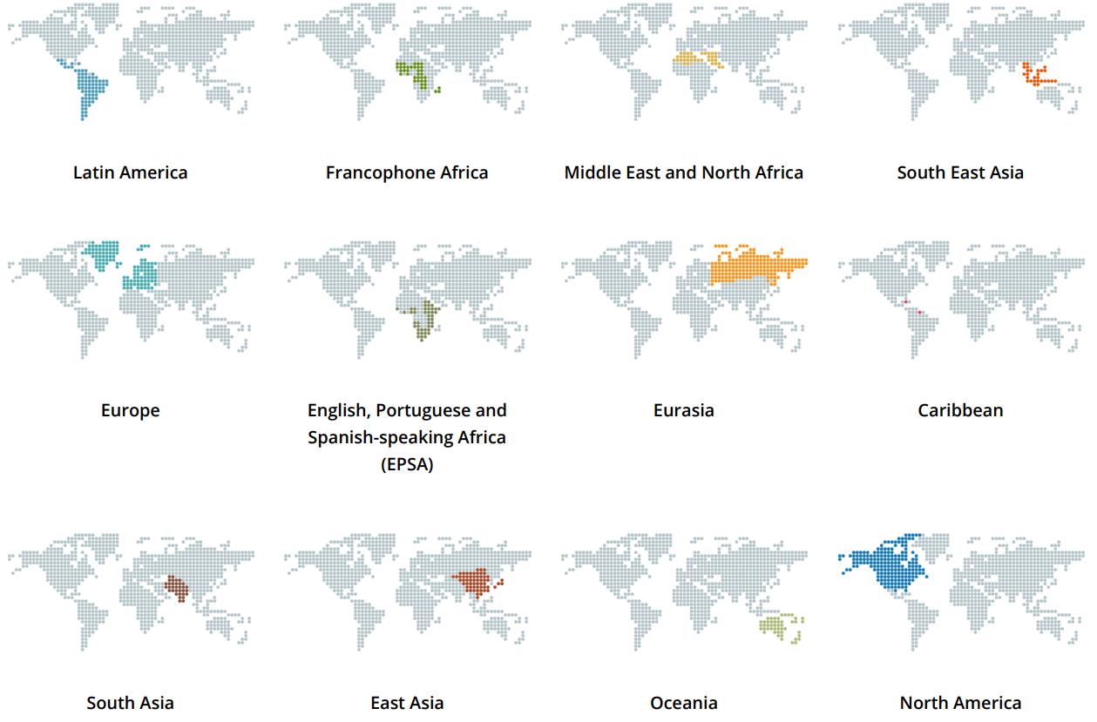
Collaborate to saturate invites us to work and pray for… Regional support networks for shared learning and encouragement.
3

Slide 24
Measurement: How will we know how we are doing?
Secure Dashboard to provide global overview for ongoing prayer and support of national initiatives
Updated twice a year
Reflects evaluation of national leaders
To show fruit of collaboration

Slide 25
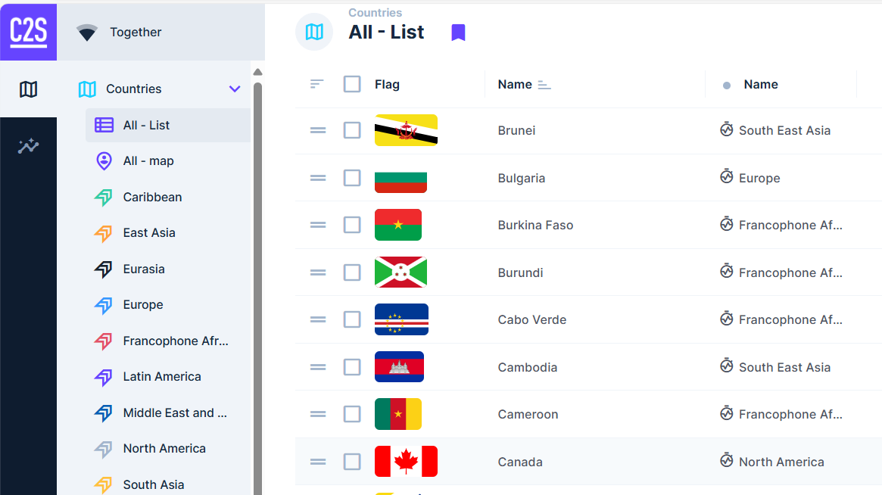

Slide 26

A gift for you!

Slide 27
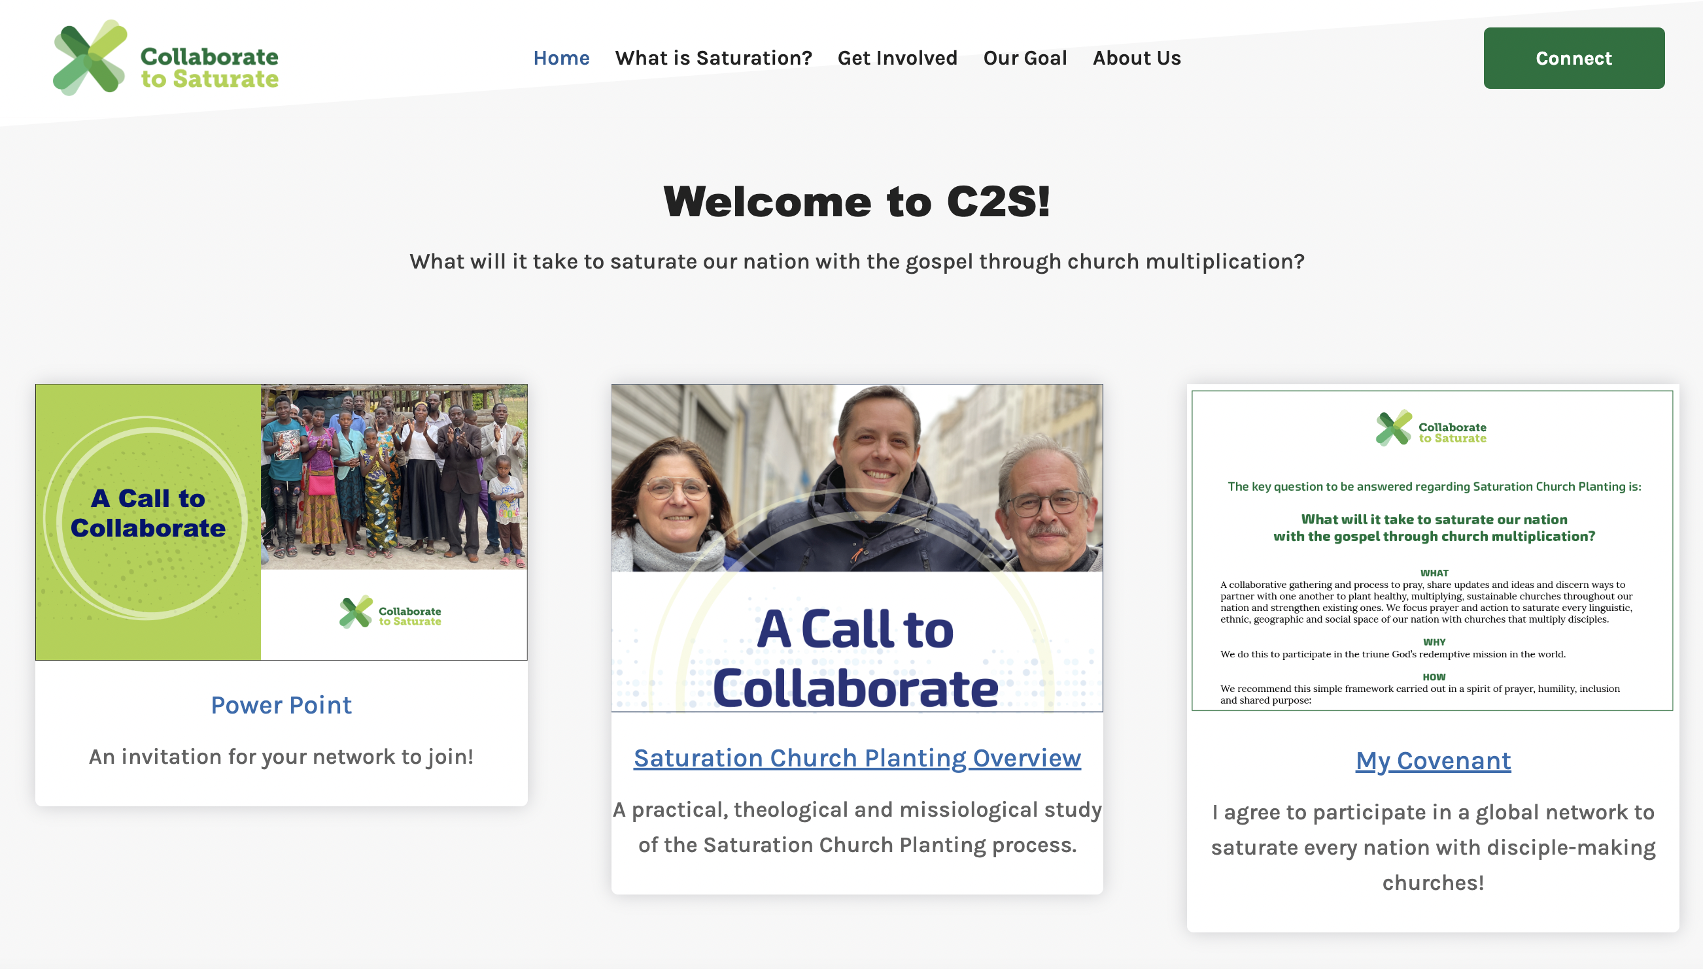

Slide 28
Thank you!

